Slide 1


India's Principal Commodity-Wise Export Analysis Using Machine Learning
A Data-Driven Approach for Trade Insights
Name : Atharva Kale
PRN: 22070521071
Semester VI C

Slide 2
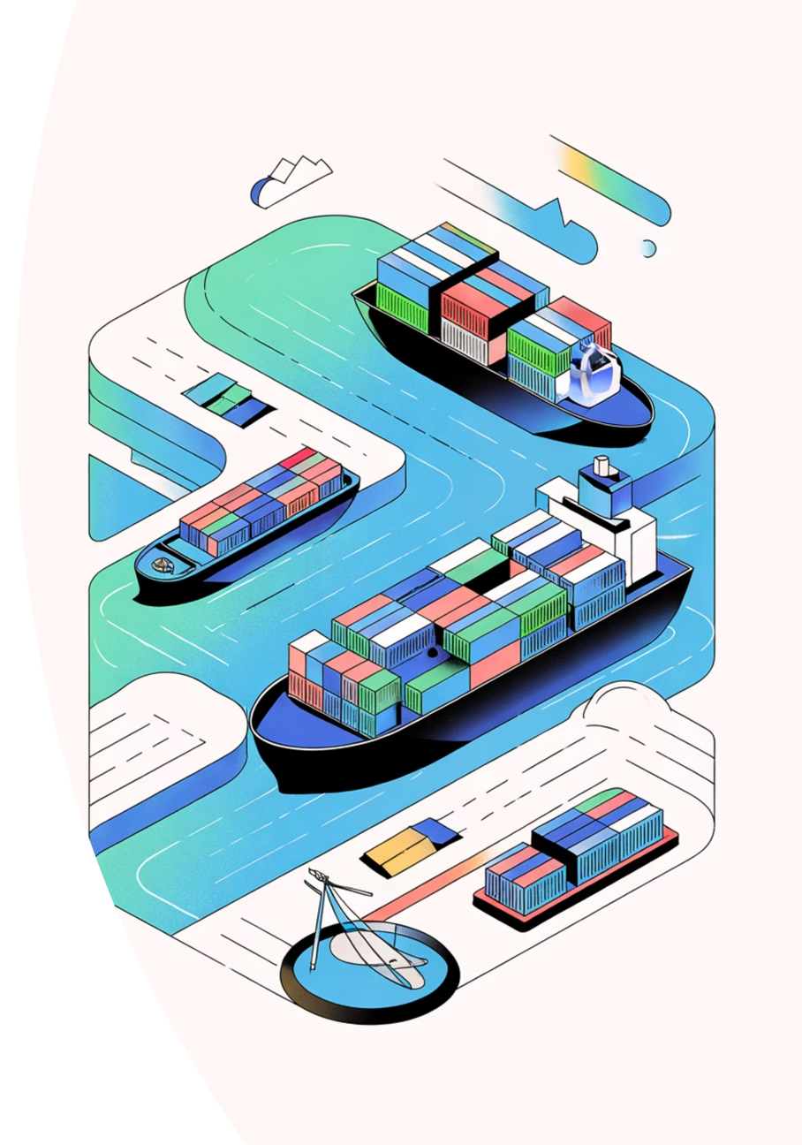







Introduction
Vast & Diversified Economy
Policy Shaping
India's export economy spans multiple sectors and commodities, creating a complex trade landscape that requires sophisticated analysis to understand fully.
Understanding export patterns and trends is crucial for policymakers to make informed decisions that strengthen India's position in global trade.
ML-Powered Efficiency
Machine learning enables efficient, automated, and scalable analysis of massive trade datasets, uncovering insights that would be impossible to detect manually.
Our methodology follows a systematic approach: Data Cleaning → Exploratory Data Analysis → Principal Component Analysis → K-Means Clustering → Interactive Dashboard Development. This pipeline ensures data quality, reveals hidden patterns, and delivers actionable insights through intuitive visualizations.

Slide 3
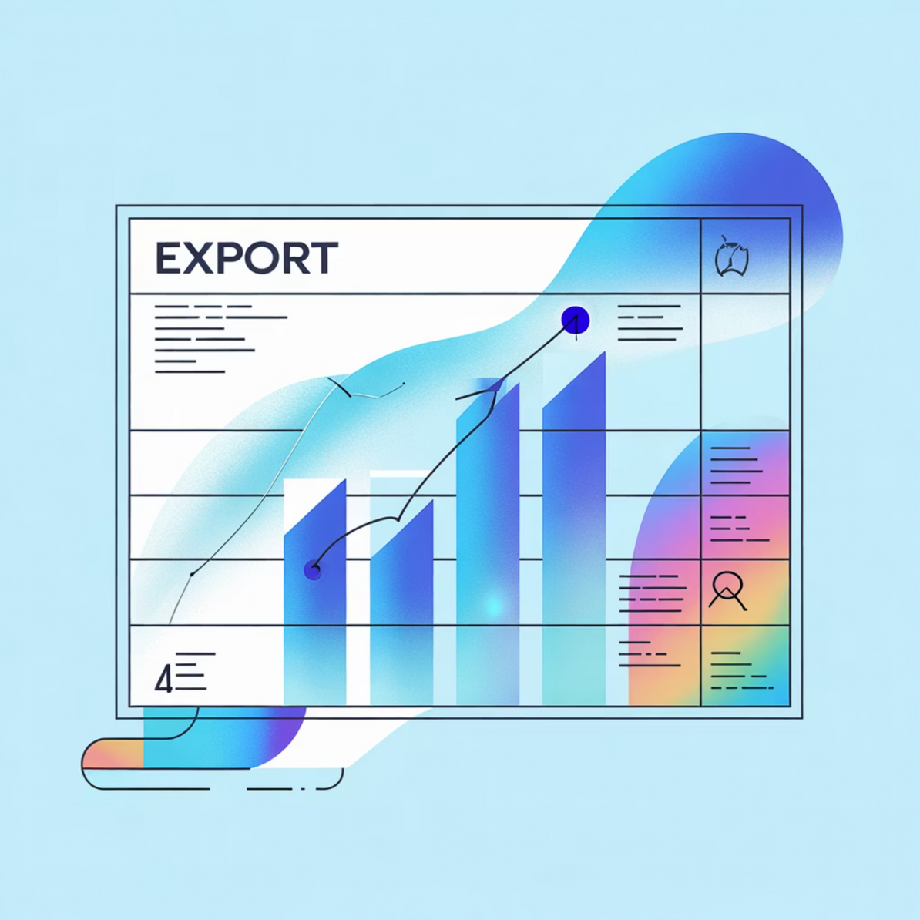
Dataset Overview
Data Source & Structure
Our analysis is built on comprehensive export data from data.gov.in, covering India's Principal Commodity-wise Export for the fiscal year 2022–23.
Link: https://www.data.gov.in/resource/principal-commodity-wise-export-year-2022-23
16,894
Total Records
Comprehensive rows of export data
6
Key Columns
Essential attributes captured
Dataset Columns
COMMODITY_NAME – Type of exported product
COUNTRY – Destination nation
UNIT – Measurement unit
QUANTITY – Volume exported
VALUE_USD_MILLION – Export value in millions
PRICE_PER_KG – Unit pricing metric

Slide 4
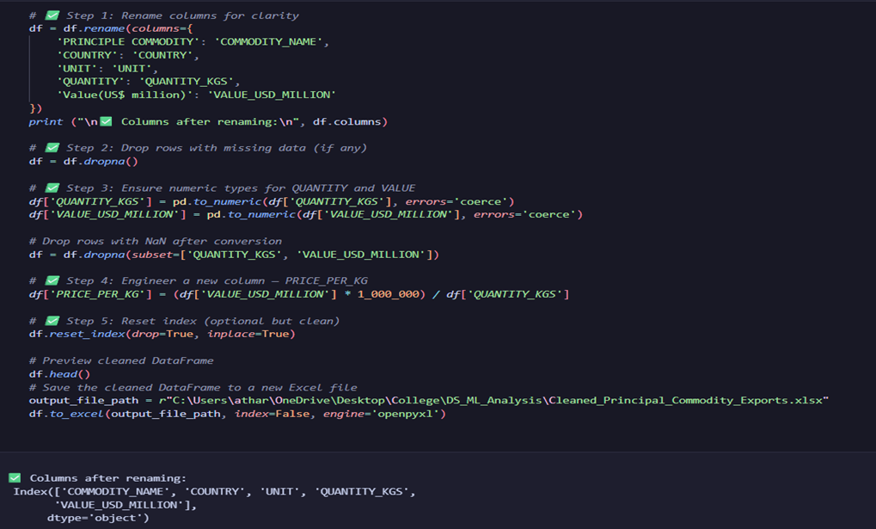
Data Preprocessing: Building a Clean Foundation

Slide 5



Exploratory Data Analysis: Uncovering Trade Patterns
Our comprehensive EDA revealed critical insights into India's export composition, market distribution, and value drivers. Through statistical analysis and visualization, we identified key patterns that inform strategic decision-making.
Top Export Commodities
Leading Export Destinations
Variable Relationships
Petroleum products, diamonds, and pharmaceuticals dominate India's export portfolio, representing the highest value categories. These sectors drive significant foreign exchange earnings.
USA, UAE, and China emerge as India's primary export markets, accounting for substantial trade volumes. Geographic diversification reduces dependency risks.
Heatmap analysis reveals correlations between VALUE, QUANTITY, and PRICE_PER_KG, distinguishing high-value luxury exports from bulk commodity shipments.
Leading Trade Partners
The analysis identified USA, UAE, and China as India's top export destinations, collectively accounting for a significant portion of total export value. This concentration highlights both opportunities and risks in India's trade relationships.

Slide 6
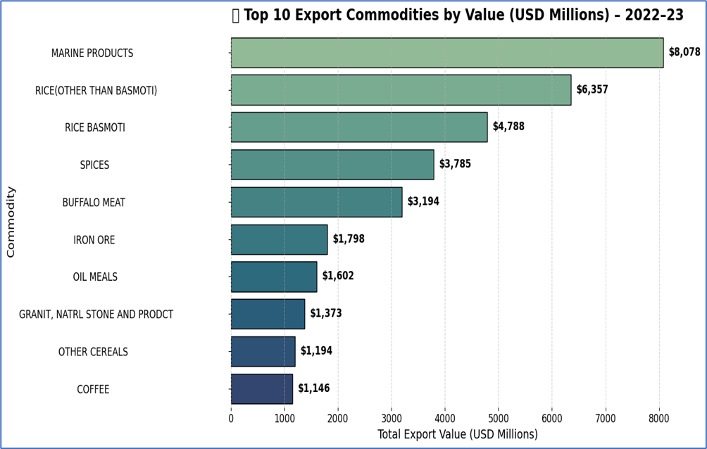
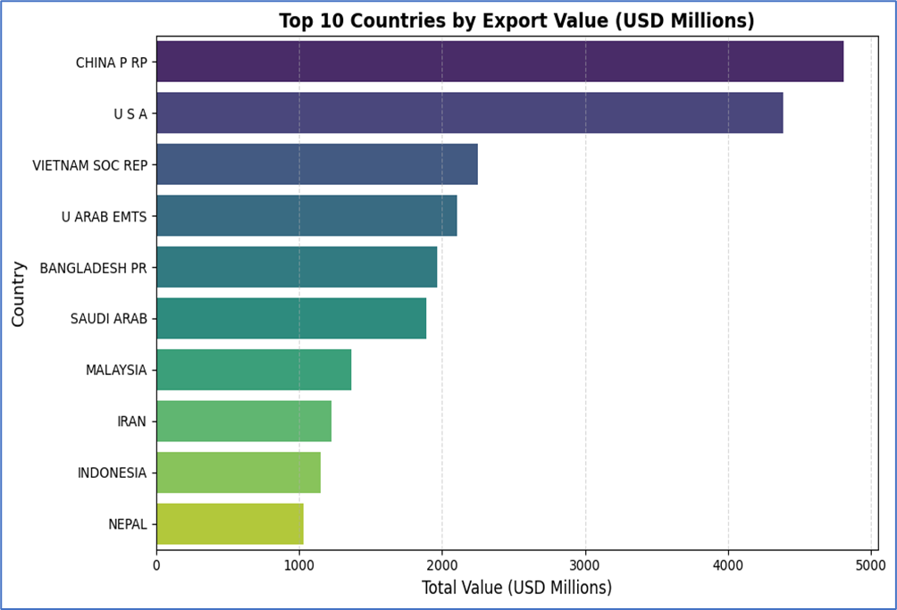
Exploratory Data Analysis

Slide 7
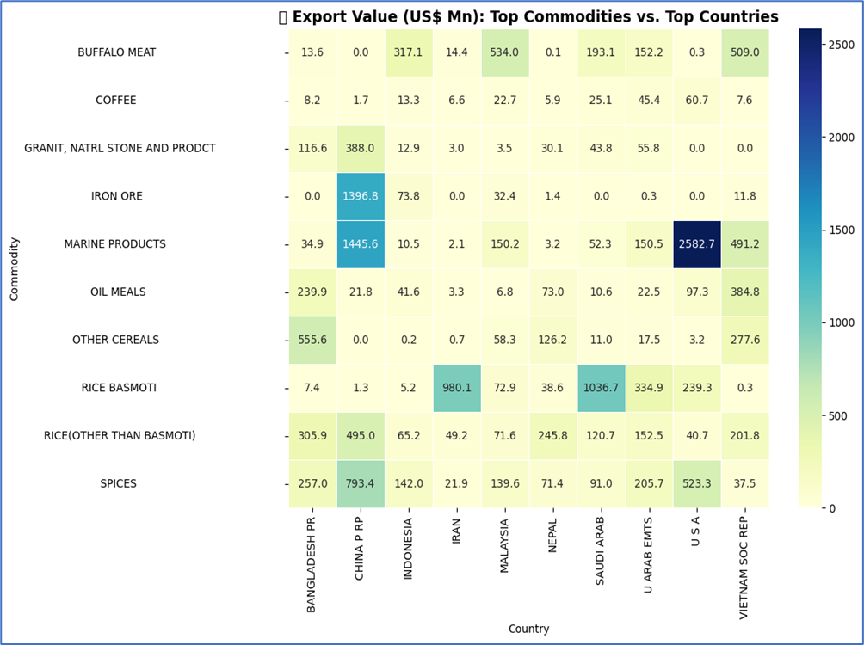
Exploratory Data Analysis
Heatmap of
Top Countries vs. Top Commodities
Metric: Export value matrix crossing top commodities and top export countries.
Visualization: Annotated heatmap where intensity reflects trade value per country–commodity pair.

Slide 8
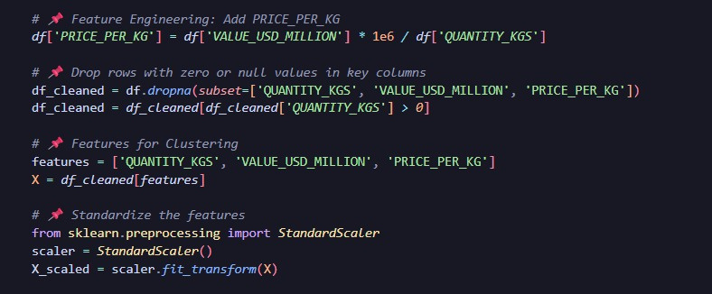
Feature Selection: Identifying Key Drivers
Strategic Feature Choice
Through rigorous correlation analysis and domain expertise, we identified three critical features that capture the essential dimensions of export performance:
QUANTITY
Volume metric indicating scale of trade operations and market penetration
VALUE_USD_MILLION
Revenue metric reflecting economic impact and foreign exchange earnings
PRICE_PER_KG
Quality indicator distinguishing premium from commodity exports
These features are distinct yet complementary, each capturing unique aspects of export dynamics. Correlation analysis confirmed minimal redundancy while maximizing information content.
Why These Features?
Correlation analysis demonstrated that while these features are related, each contributes unique information:
Low multicollinearity – Features are independent enough to avoid redundancy
High predictive power – Each feature strongly influences export patterns
Business relevance – Directly interpretable for strategic decision-making

Slide 9
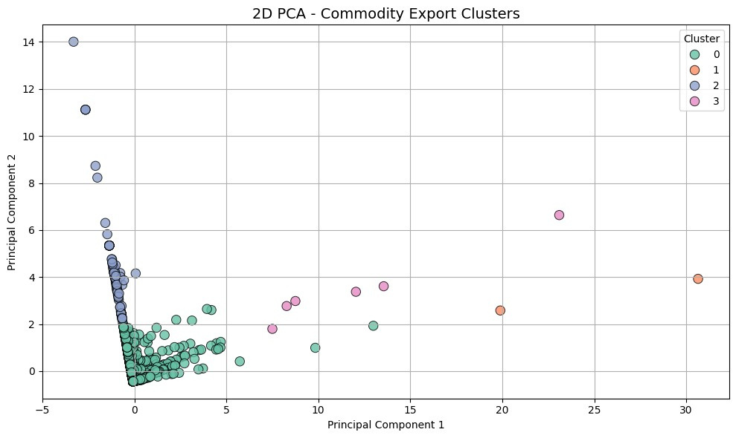


Model Preparation: Scaling & Dimensionality Reduction
Preparing data for machine learning requires normalization and dimensionality reduction to optimize model performance and enable effective visualization.
StandardScaler Normalization
Principal Component Analysis
Enhanced Visualization
Applied StandardScaler to normalize all features to zero mean and unit variance. This ensures that features with different scales (quantity in thousands vs. price per kg) contribute equally to distance-based algorithms like K-Means clustering.
Reduced three-dimensional feature space to two principal components while retaining 92.5% of the original variance. This dimensionality reduction simplifies visualization without significant information loss.
Two-dimensional PCA representation enables intuitive scatter plot visualization of export patterns, revealing natural groupings and outliers that inform clustering decisions.
PCA Performance Metrics
92.5%
2
Variance Retained
Components
Information preservation after dimensionality reduction
Reduced from 3D to 2D space

Slide 10
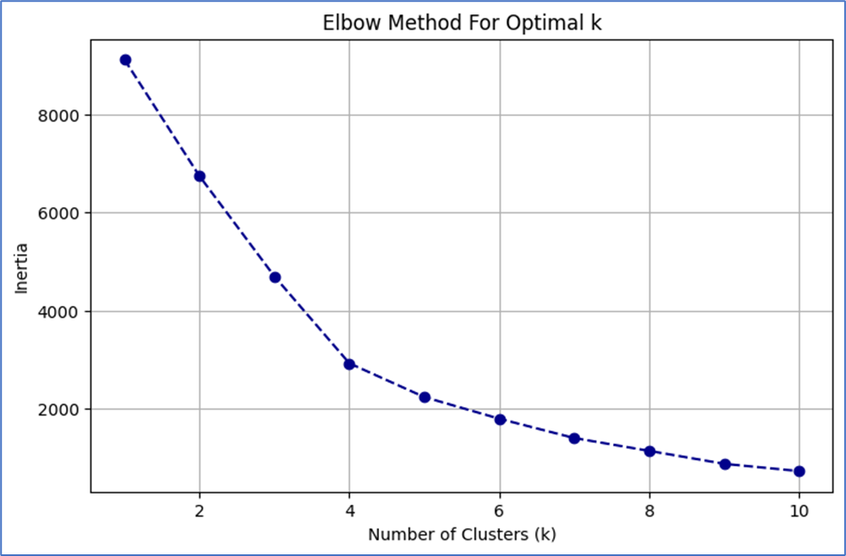
K-Means Clustering: Segmenting Export Categories
Using the Elbow Method, we identified k = 4 as the optimal number of clusters, balancing model complexity with meaningful segmentation.

Slide 11
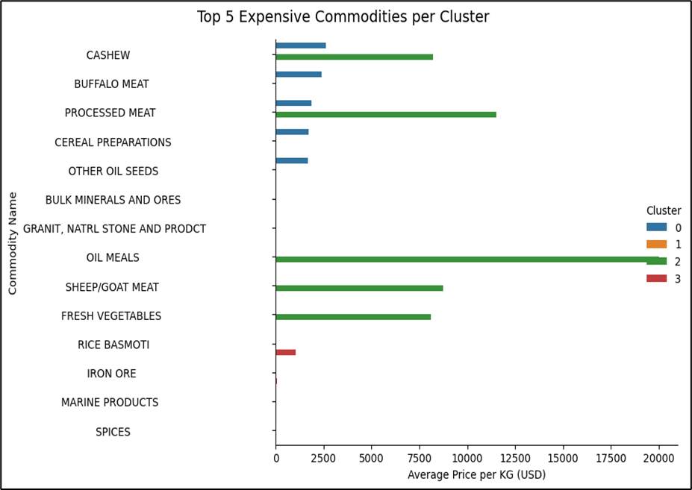
Cluster-Based Commodity Segmentation Analysis
Top 5 Expensive Commodities per Cluster:
Each cluster contains a set of high-priced commodities.
This analysis helps highlight elite commodities within their segment, showing hidden gems in mid-range or even bulk-focused clusters.
It also reveals price variability within clusters.

Slide 12
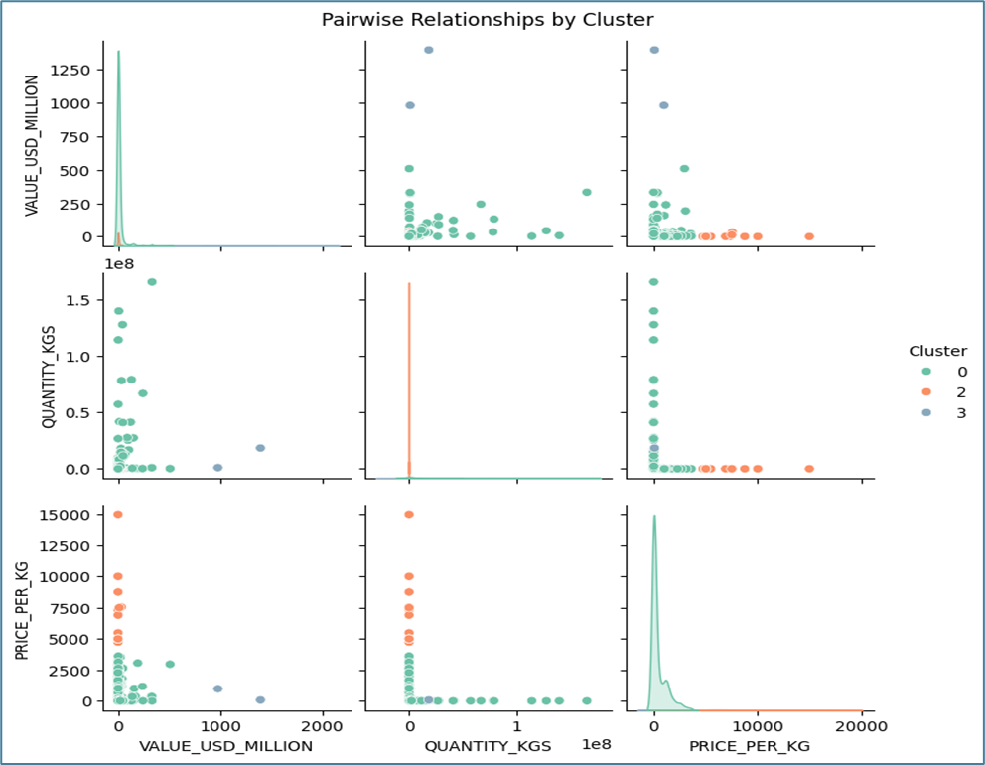
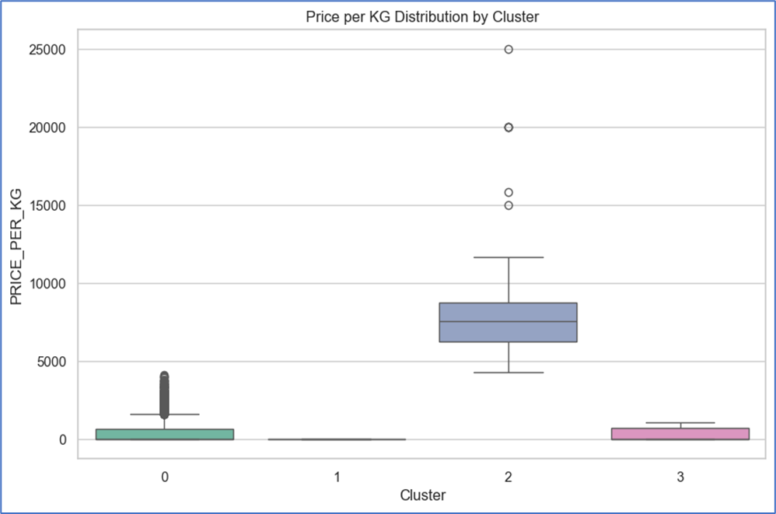
Cluster-Based Commodity Segmentation Analysis

Slide 13
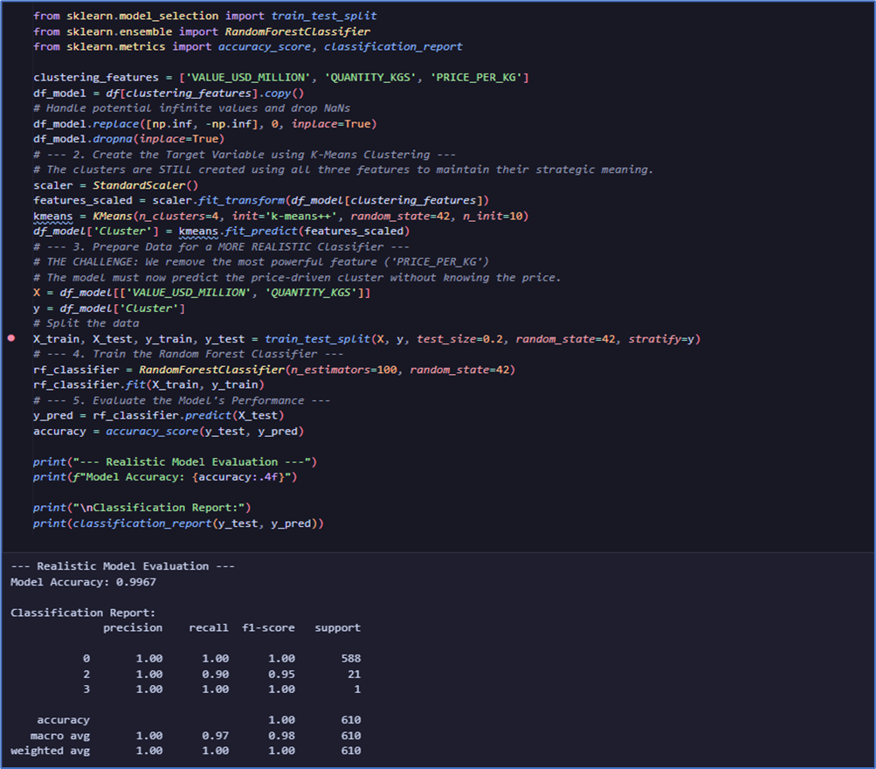
Random Forest Regressor
Output:

Slide 14
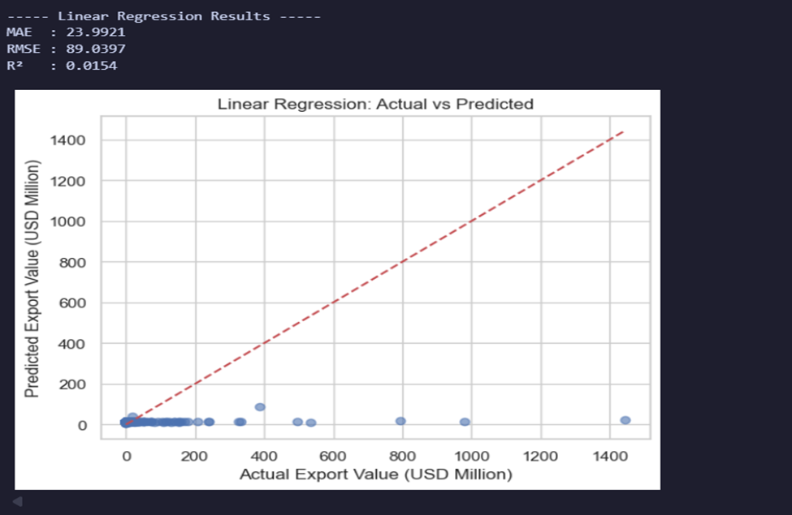
Linear Regression

Slide 15
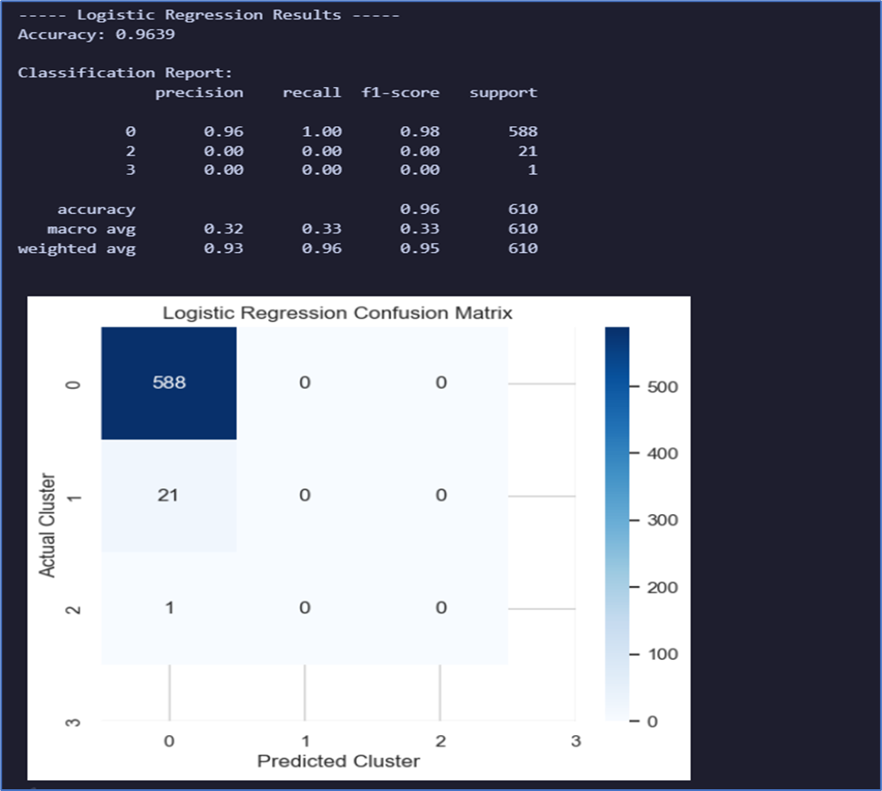
Logistic Regression
Output:

Slide 16
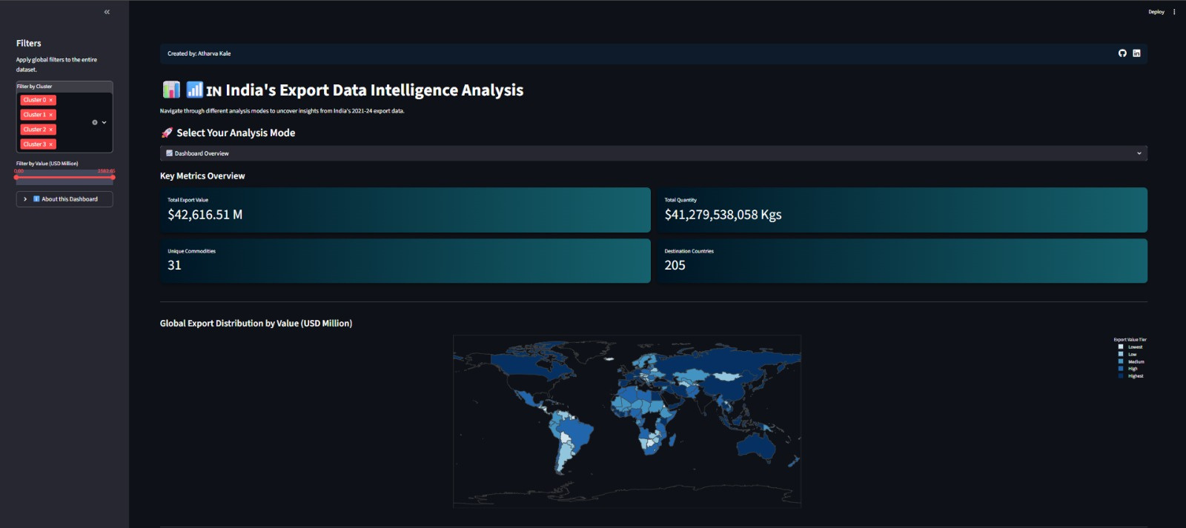
Streamlit Dashboard & Future Directions

Slide 17
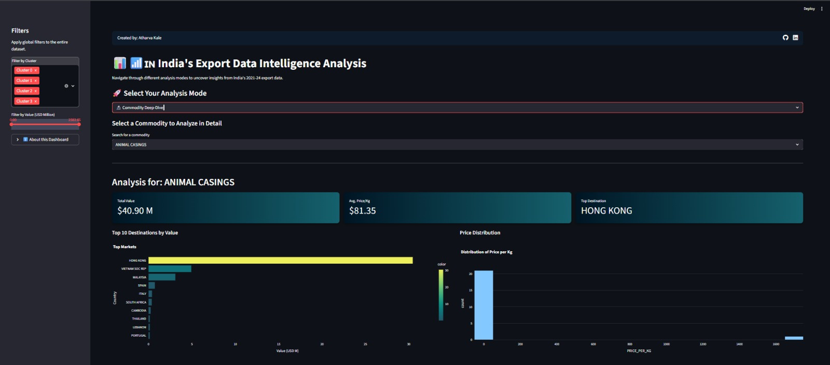

Slide 18
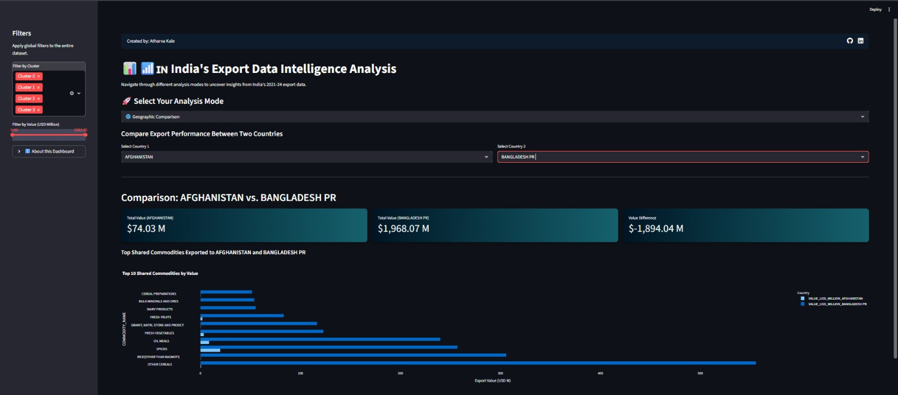

Slide 19
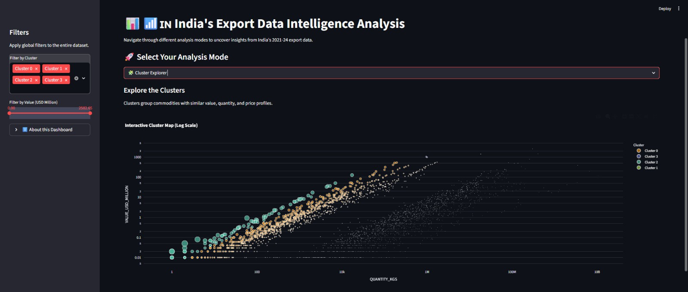

Slide 20
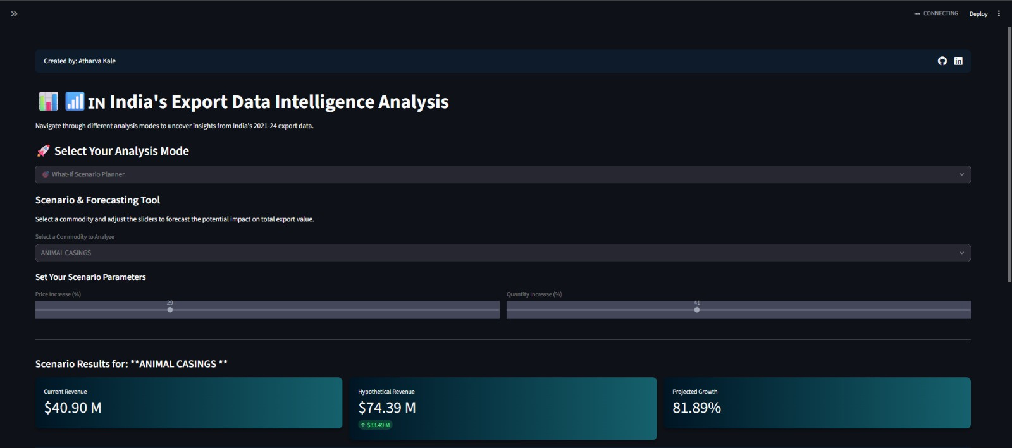

Slide 21

Thank You

